Slide 1
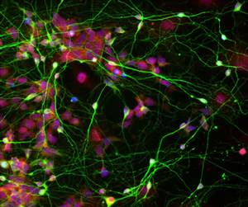
Cellular Organization and Structure

Slide 2
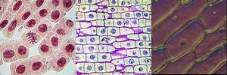
Cell Theory
Cells are the basic units of life.
All organisms are composed of one or more cells.
All cells come from pre-existing cells.

Slide 3
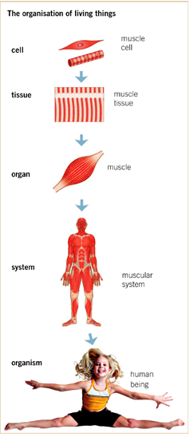
Organization of living things
Cells → Tissue → Organ → Organ System → Organism

Slide 4
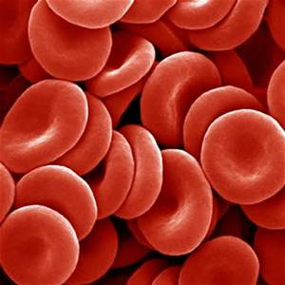
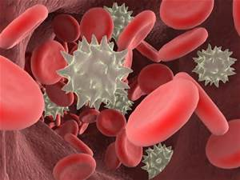
A cell’s structure determines its function!

Slide 5
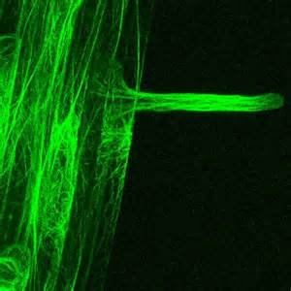
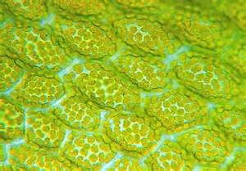
Structure = Function

Slide 6
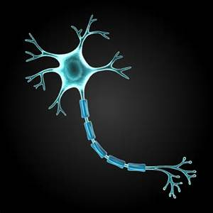
Specialized Eukaryotic Cells
Eukaryotic cells are multicellular
- allows for a specific cell to specialize in order to accomplish a specific task
The way cells are built helps them do their job!
- structure determines function!

Slide 7
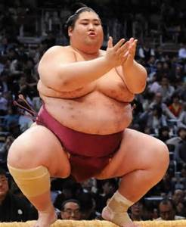
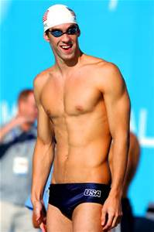
Structure = Function

Slide 8
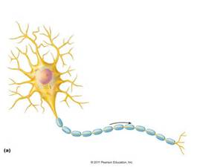
Structure = function
-How does a football’s structure help with its function?
- How does a neuron’s (brain cell) structure help with its function?

