Slide 1
Unit 3:Communities
Environmental Science
Notes:
Everyone needs to get out a separate sheet of lined paper. Put your name on it!
At the top write “Unit 3: Communities Vocabulary”

Slide 2
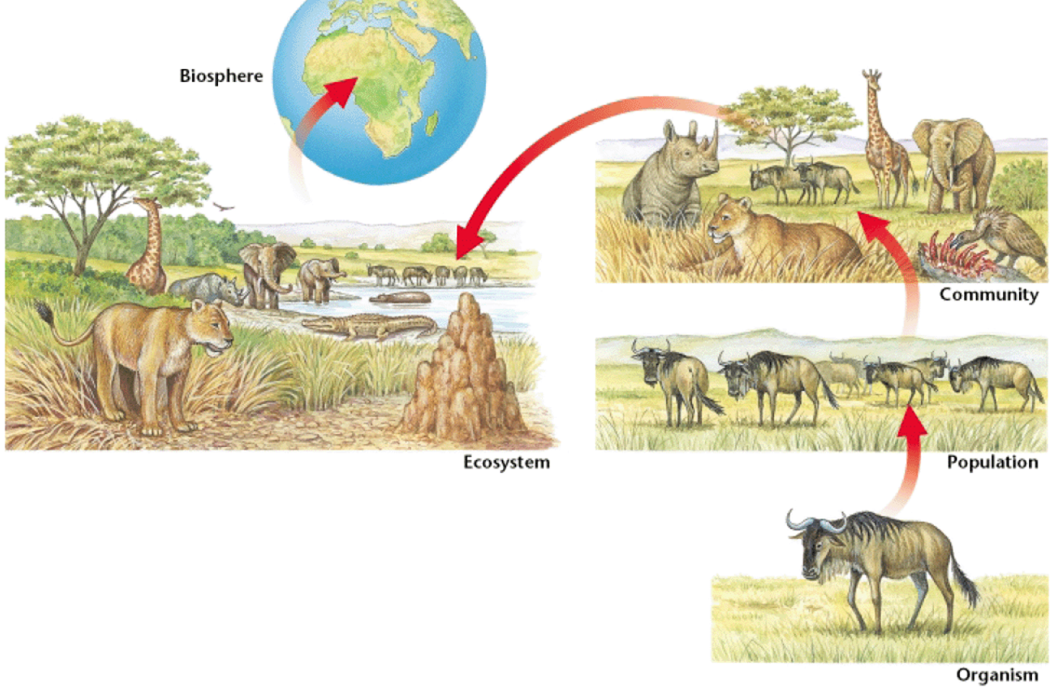
Levels of Organization
Notes:
So far we have discussed species (one type of organism) and population (a group of the same species living in one area)
Now we are going to talk about communities
What are some communities that come across everyday? (schools, clubs, neighborhoods, etc.)
What do they all have in common? (different groups of people, from different walks of life)

Slide 3
Community- multiple species living in one area, interacting with each other
Every population is in a community
The major difference between communities is the different species within them.
  Ex. A community in the north pole would be different than a community in a rainforest
Land Communities rely on plants for food
  Plants are PRODUCERS
Notes:
On your new vocabulary paper write down this definition.
Color of the day is BLUE

Slide 4
All life depends on the sun
Energy from the sun goes into an ecosystem when plants use photosynthesis
  Plants are Producers

Slide 5
Producers-Make energy (sugar) from inorganic materials
Also called AUTOTROPHS-self feeders
Examples: Plants, algae and bacteria

Slide 6
CONSUMERS-eats other organisms or organic matter to make energy
Also called HETEROTROPHS- Other feeders
  Get energy indirectly through producers or other consumers
Notes:
Which category would a buzzard go under?

Slide 7
What Eats what?
Herbivore- plant eater
  Ex. Deer
Carnivore- meat eater
  Ex. Wolf
Omnivore- eats both plants and meat
  Ex. Bear
Decomposer- breaks down organic materials for energy
  Ex. Bacteria
Notes:
Give me more examples

Slide 8
Burning fuel
An organism gets energy though what it eats
The body must break down the food to get the energy
Cellular Respiration- process of breaking down food to get energy
  Happens inside your cells
Notes:
Cellular Respiration- process where cells produce energy from carbohydrates (sugar); atmospheric oxygen combines with glucose to form water and carbon dioxide

Slide 9
Energy Transfer
Any time an organism eats another organism, energy is transferred
You can study the energy transfer in food chains, food webs and trophic levels

Slide 10
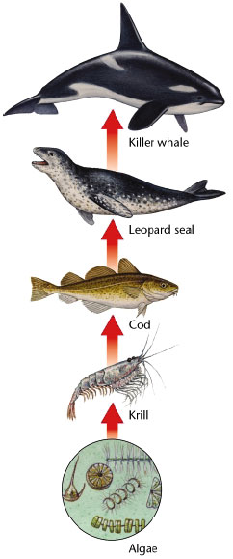
Food Chain
Food Chain- the order of energy being transferred from one organism to the next by eating

Slide 11
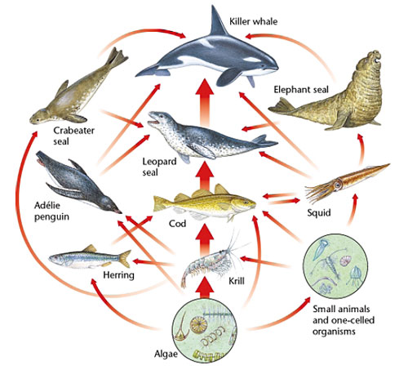
Food Web
Food Web- shows feeding relationships in an ecosystem
Several food chains connected together

Slide 12
Trophic Levels
Trophic Levels- each step of energy transfer in a food chain or food web
Levels
  Producers
  Primary Consumers
  Secondary Consumers
  Tertiary Consumers
  As you go up each level you get fewer and fewer organisms
    Why?

Slide 13
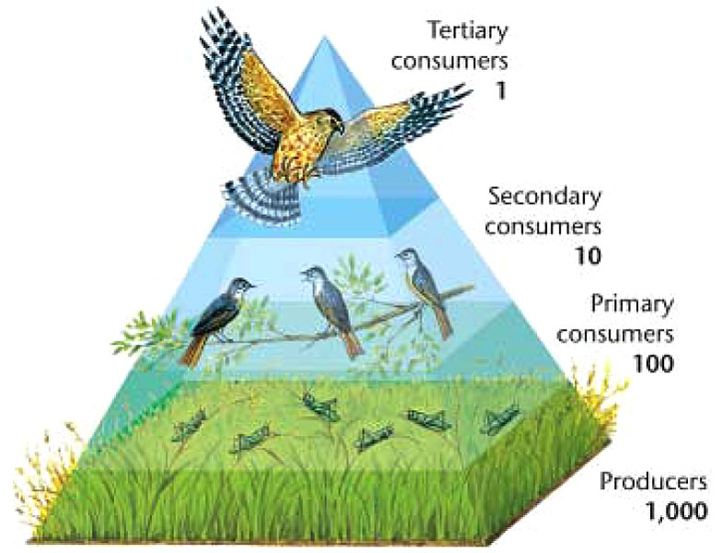
Trophic Levels
Each time energy is transferred, some energy is lost as heat
Less energy is available to organisms at higher trophic levels
The pyramid gets smaller at the top where less energy is available

Slide 14
Succession
Ecosystems are constantly changing.
Succession- gradual process of ecosystems changing and developing over time.

Slide 15
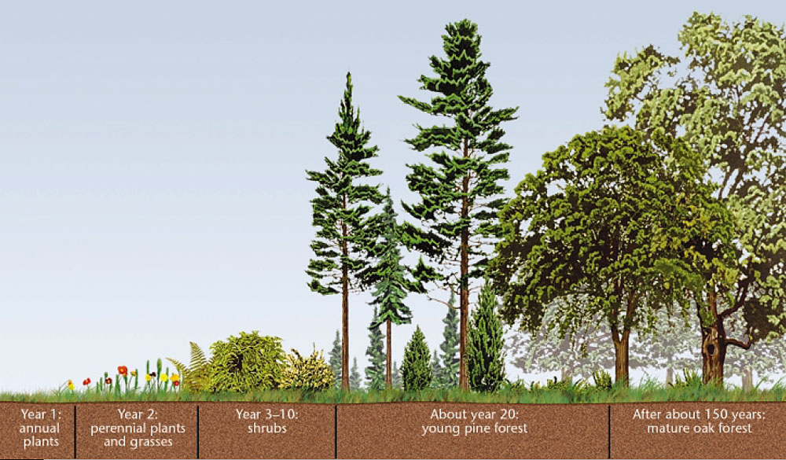
Succession

Slide 16
Keystone species-An organism in an ecosystem that impacts all other members in some way

