Slide 1
Food for Thought
Write what you think the term Environmental Science, means.

Slide 2
Introduction to Environmental Science

Slide 3
Learning Targets
By the end of this lesson, I will be able to define environmental science
By the end of this lesson, I will be able to describe the importance of studying environmental science
By the end of this lesson, I will be able to identify important factors of environmental science

Slide 4
What is Environmental Science?
Environmental Science: the study of the environment and solutions to environmental problems
It includes the study of human impact on the environment

Slide 5
Goal of Environmental Science
To Understand and solve environmental problems
Environmental scientists study the two main types of interactions between humans and their environment
The use of natural resources
How our actions alter our environment

Slide 6
Environmental Science is Important
Governments, businesses and cities recognize that studying our environment is essential to maintaining a productive society
Observations from nonscientists are the first steps toward fixing an environmental problem

Slide 7
Humans Impact their Environment
Wherever humans hunt, grow food, throw away or settle, they change the environment

Slide 8
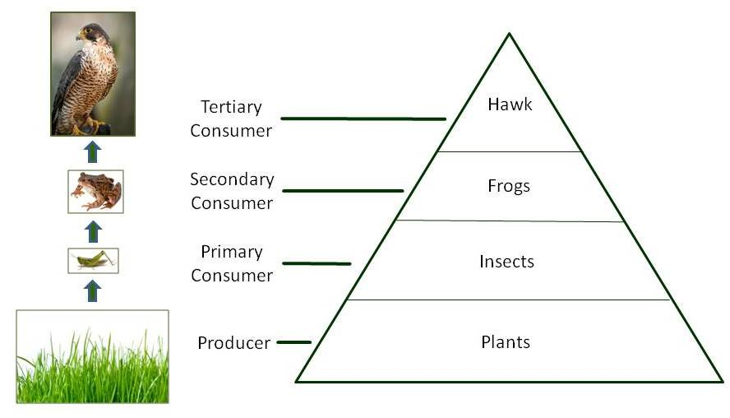
Population
Group of individuals of the same species living within the same geographic area
All connected and depend on one another
Notes:
Producers—photosynthesis
Plants transpire (give off oxygen)
Primary Consumer--- eats producer
Animals respire (give off Co2)
All impact natural processes

Slide 9
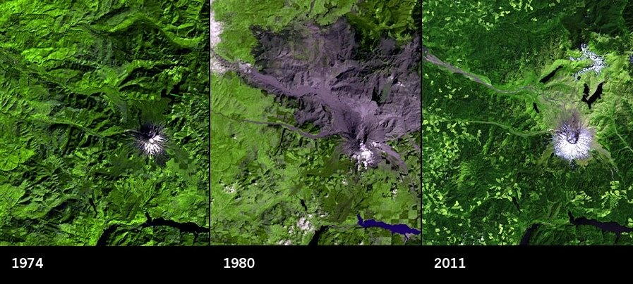
Sustainability
The ability to maintain resources
It’s the smart thing to do
Notes:
Mt. Saint Helen
Erupted and destroyed the surrounding forest. It came back in record time, people said that it was nature. In reality the land is owned by a lumber company, who replanted all the trees in the area.
Currently there is more forest in the US than ever before in history. This is because of the lumber companies. For every tree they cut down they plant 10 more.

Slide 10
Communities
Different populations living in the same area

Slide 11
Ecosystem
Different communities living in a general area

Slide 12
Biodiversity
“Diversity of life”
The variety of organisms/communities in a given area
Organisms in an environment are natural resources
We depend on them for food and the air we breath

Slide 13
Succession
Earths ability to heal itself

Slide 14
Pollution
Land
Air
Water
Water never goes away but it does become unusable

Slide 15
Energy
Nonrenewable energy
Renewable energy

