Slide 1
Eukaryote vs Prokaryote
Introduction to Cell Vocabulary

Slide 2
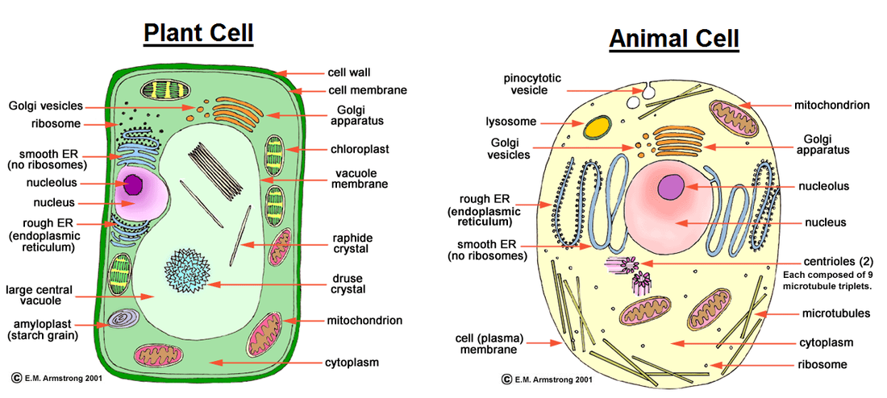

Slide 3
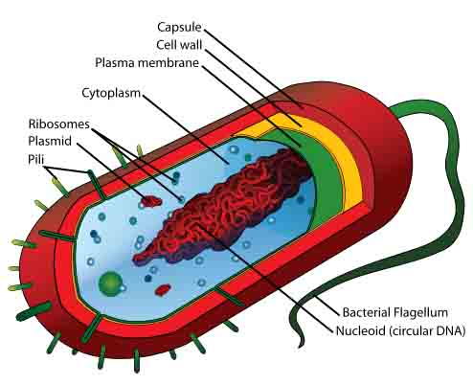
Prokaryote / Prokaryotic Cells
These cells do NOT have a nucleus. Bacteria are examples of prokaryotic cells.

Slide 4
Eukaryote / Eukaryotic Cells
These cells DO have a nucleus. Plant & animal cells are 2 examples of eukaryotic cells. (There are many more examples!)

Slide 5
