Slide 1
Population
Environmental Science
Ms. Kohnke

Slide 2
Why Do We Cover Population?
Population impacts….
Environmental Resources
Space (land)
Waste
Earth’s resources are limited
Most environmental issues are caused by overpopulation

Slide 3
What is a Population?
Population- a group of the same species that live in the same geographical area
Populations stay around the same size from year to year

Slide 4
How Does a Population Change in Size?
A population gains individuals with each new offspring
A population loses individuals with each death
Disease
War
Age
Famine
Drought
Change in Population can be calculated by…
+
Change in Population Size
Births
Deaths

Slide 5
What Limits Population Growth
Populations cannot increase forever.
Eventually, resources are used up or the environment changes, deaths increase or births decrease
THINK: what happened in The Lorax?

Slide 6
How do we Know How Many are in a Population?
Birth Rate- amount of live births each year
$\frac{Number of live births}{1000}$ per year
Death Rate- number of people that die per year
Rate of Natural Increase- the amount the population changes (increase/decrease)
$\frac{Birth Rate −Death Rate}{10}$ per year

Slide 7
Studying Human Populations
Countries are often grouped in two different categories-Developed and Developing Countries
Developed Countries- higher incomes, less population growth, strong social support systems, and have diverse industrial economies
Developing Countries-low incomes, rapid population growth and simple agriculture-based economies

Slide 8
World Population Clock-Video
We will watch the video twice.
First View: just watch, pay attention to the lights (they represent populations)
Second View: on your sticky note, respond to the thoughts below
Did you ever see the lights vanish? Why do you think that is?
Where were the majority of the populations located? Why do you think that is?
Notes:
Populations typically develop near water sources. In the video, populations were shown near the coasts and major rivers. This is because that is where trade was
Big increase in numbers during the 1800s because of industrial revolution
See the population go down in some areas because of the plague and fall of empires

Slide 9
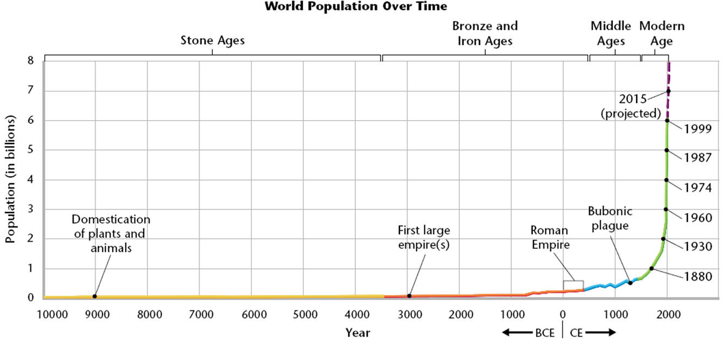
Human Population Over Time

Slide 10
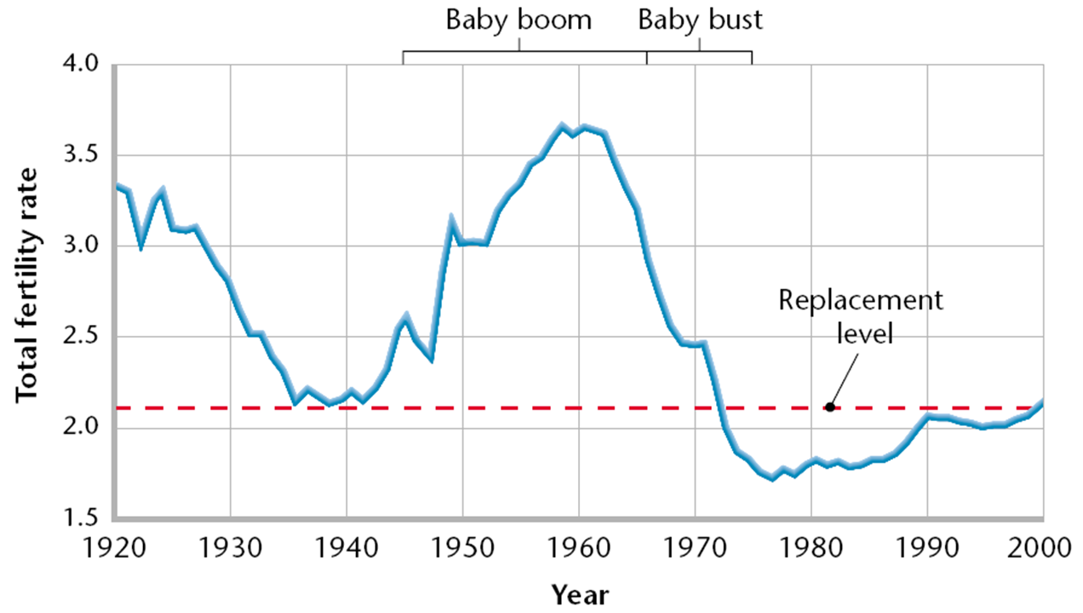
Fertility Rates
Fertility Rate- average number of children per woman
Example: 2.06 in USA
Replacement Level- number of children each parent must have to “replace” them. It is slightly more than 2 because not all children born will survive to reproduce.

Slide 11
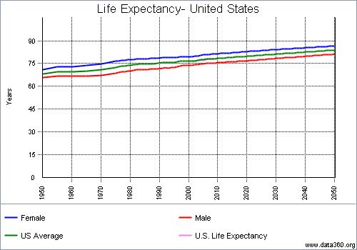
Life Expectancy
Life Expectancy- average of how long people live over a lifetime
The higher the life expectancy the better the health care and diet

Slide 12
Problems of Rapid Population Growth
Resources are used faster than the environment can renew them.
Signs of overwhelming populations are…
Suburban sprawl
Polluted rivers
Barren land
Inadequate housing
Over crowded schools
This results in
Unsafe water
Impacts on land
Urbanization

